Slide 1

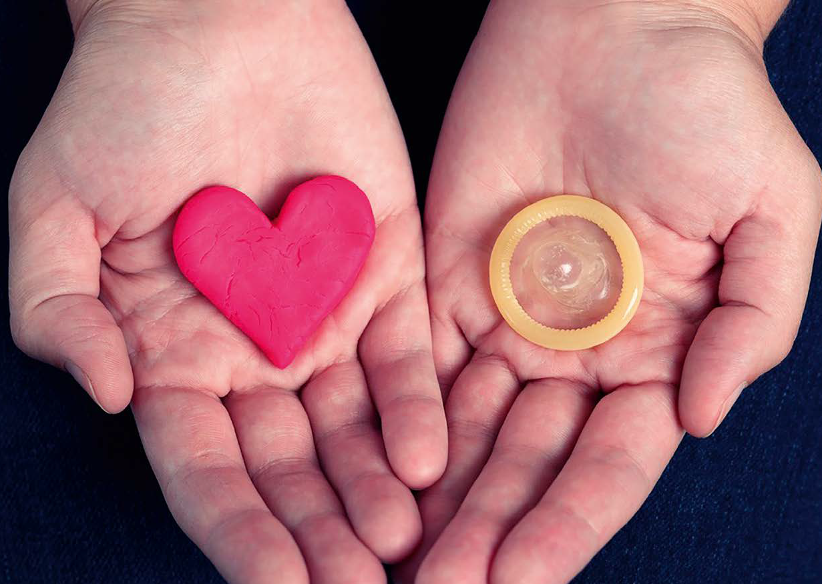
Service integration and sexual health
Dr. Silke David
National Institute of Public Health
and the Environment
July 22nd 2018

Slide 2
Disclosure of interests
 | none
Potential conflict of interests | none

Slide 3
Link animation:
https://youtu.be/YaD4P3S6wUA
https://www.rivm.nl/sti

Slide 4
Basis integrated approach
Historically we are an inclusive, participatory society
    society with open scope
    Non-traditional social norms
    openness towards different opinions
      Acceptance of diversity in gender identity and sexual orientation
Emphasis on positive sexual health and pleasure
Co-creation

Slide 5

Public health and service integration
    prevention + cure + care + key pops
network partners involved in:
          Health care professionals
          Patient support groups
          Communities/key populations
          National NGO’s (monitoring & prevention interventions)
          Research institutes
          Policy advisors
          etc.
          National Action Plan

Slide 6
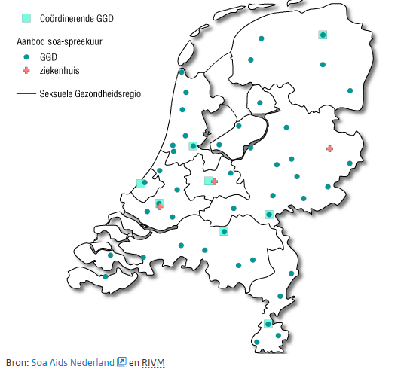






How the system works
Centers for sexual health care
Municipal Public Health services
subsidies
Data for M&E
&action
&policy update
NGO’s

Slide 7
How the system works
Municipal Public Health services
Centres for sexual health care
Additional care
Low threshold
High quality & competent care
High risk groups
Integrated service
STI &HIV testing & treatment
Counselling
Sexual health consultations
Outreach
E-health

Slide 8
National Action Plan STI/HIV and Sexual Health
Strategic goals
Facilitating government
Residents of the Netherlands are well informed and capable of making choices about their sexual health, aiming for sex that is pleasant, voluntary and safe, protected against STIs and HIV, sexual violence and unwanted pregnancies.
Accessibility of care
Residents of the Netherlands have access to appropriate, affordable health facilities, care, advice, support and protection if they need help or have problems related to their sexual health, including STIs and HIV.

Slide 9
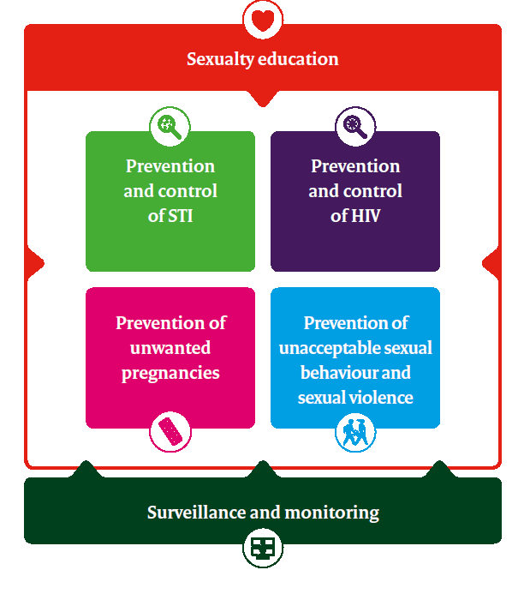
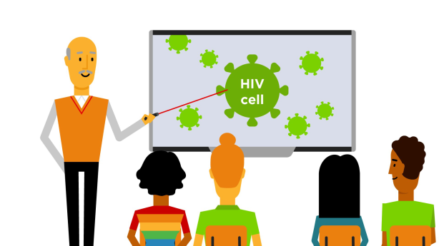

National Action Plan STI/HIV and Sexual Health
Source: www.rivm.nl/STI
National Action Plan STI, HIV and Sexual Health 2017-2022

Slide 10

Goals for HIV control
From cascade to continum of care
          No of AIDS death’s = zero
          Reduction with 50% of new HIV infections
          Reduction of co-infections
          Improvement of quality of life of PLWH
            Normalization of testing/treatment
            Reduction of stigma
92%
95%
95%
95%
95%
90%
89%
90%
diagnosed treated suppressed
diagnosed treated suppressed

Slide 11


Challenges HIV control
Support innovations in control and testing:
    Seduce late presenters to earlier test&treat
    Improve (online) partner notification
    Improve availability of customized (self) testing
    Implement community based testing
    Develop and implement sexual health app’s

Slide 12


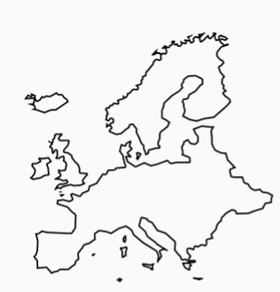
Challenges HIV control
In spite of open society constant efforts necessary
approaches together with communities
  NL= small country
  customized approaches needed for
      (fast track) cities
      and more rural area’s

Slide 13
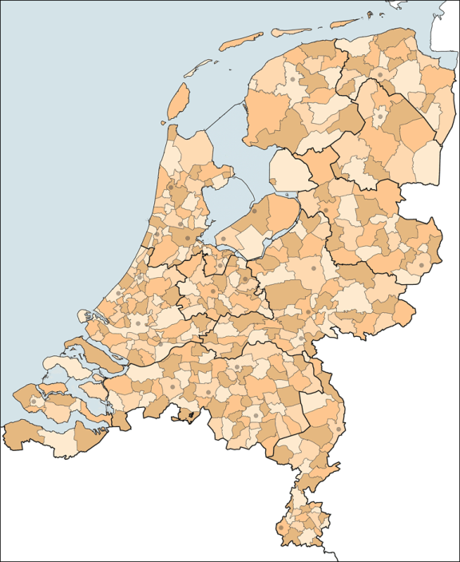
Challenges related to system changes
(barriers of EU legislation > continuation of issuing subsidies)
National laws > prohibit community based testing
Decentralization of government > affect organization of STI-clinics
24 Municipal Public Health services
400 Municipalities

Slide 14
Challenges related to system changes
  Positive: offers possibilities to reach certain key poulations
  Negative: No comprehensive, uniform policy
        every municipality invents the wheel again
Public Health
needs a centralized approach
And a firm national policy!

Slide 15

Seven words banned
form agency [CDC] budget documents, according to Washington Post:
As part of strategy to get approval of congressional republicans
vulnerable
evidence-based
science-based
diversity
transgender
entitlement
fetus

Slide 16
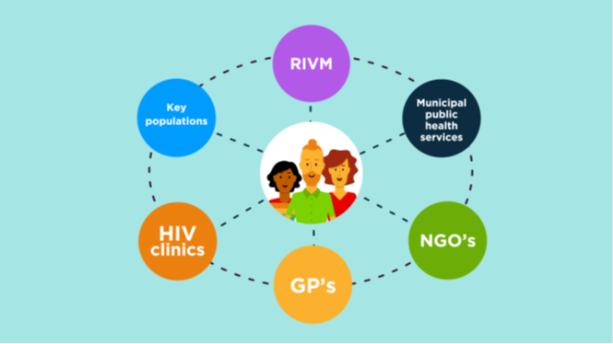
More info at www.rivm.nl/sti

Slide 17
Thanks to
  Many people at:
  Ministry of Health
  RIVM/CIb
  SANL
  Rutgers
  SHM
  HV
  HIV specialists & nurses
  Sexologistst
  General practitioners
  Centers of Sexual Health at Municipal Public Health Services
  Communities/volunteers
  All others!

